Slide 1



Human Motion Sensing with WIFI Passive Radar
Reference: Through-Wall Human Sensing with WiFi Passive Radar
Hongbo Sun, Senior Member, IEEE, Lek Guan Chia, and Sirajudeen Gulam Razul
Index Terms
Human Motion Sensing
WIFI Passive Radar
Software Defined Radio
Doppler Detection
Haodong Zhang 12113010 2024.1.12
Dept. of Electronic & Electrical Engineering
Southern University of Science and Technology China

Slide 2
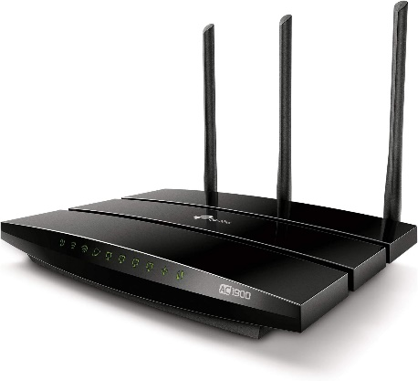
Background
Human sensing
Application
How to do?
Security and surveillance
Healthcare and monitoring
Smart homes
Military and law enforcement
Search and rescue
……
Wearables systems
Camera systems
Infrared sensors
Active radars
Passive radars
Personal privacy
Portable and lower cost
Undetectable
Can penetrate the wall
Widely deployed
Promising Technique:
WIFI Sensing

Slide 3
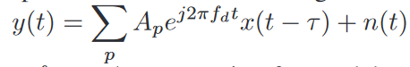
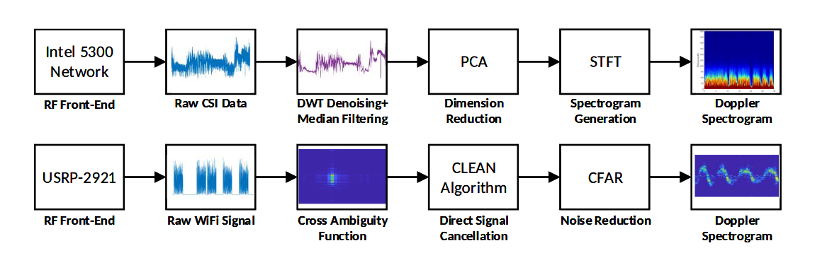

The Principle of WIFI Sensing
Taxonomy of WIFI sensing
Channel State Information (CSI)
Passive WIFI Radar (PWR)
Main idea behind WIFI sensing
Moving person will affect the communication channel of a WIFI signal: Doppler frequency shift, propagation paths and signal attenuation
A Taxonomy of WiFi Sensing: CSI vs Passive WiFi Radar, W. Li∗,M.J.Bocus†,C.Tang∗,S.Vishwakarma∗, R. J. Piechocki†, K. Woodbridge‡, K. Chetty∗

Slide 4
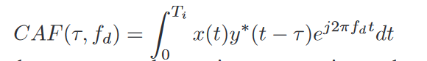
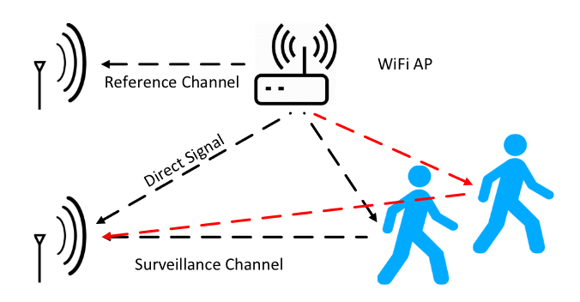
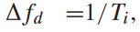
The Principle of WIFI Sensing based PWR
Cross ambiguity function (CAF)
Due to the limited bandwidth B of a WIFI signal, the range resolution Δτ = C/2B is not sufficient for indoor applications (between 7.5 to 1.875 meters).
Doppler resolution:
This allows the Doppler resolution to be adjusted for detecting human activities.
Passive WiFi Radar for Human Sensing Using a Stand-Alone Access Point, Wenda Li , Robert J. Piechocki, Karl , Chong Tang, and Kevin Chetty

Slide 5
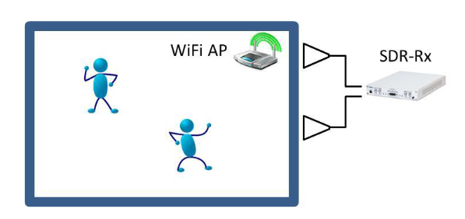
Objective and System Model
Human sensing with WIFI
Objective
Sense major motions: walking and hand waving hand…
Sense minor motions: keyboard typing…
Device
Commercial WIFI router:
Under normal data communication
without any synchronization with the passive radar receiver
No directional high-gain antenna
SDR (USRP) and two wideband horn antennas Omni-directional antenna
Contribution
Received Signal Strength (RSS) model to localize the WIFI AP position
Iterative Adaptive Approach (IAA) to improve Doppler resolution

Slide 6
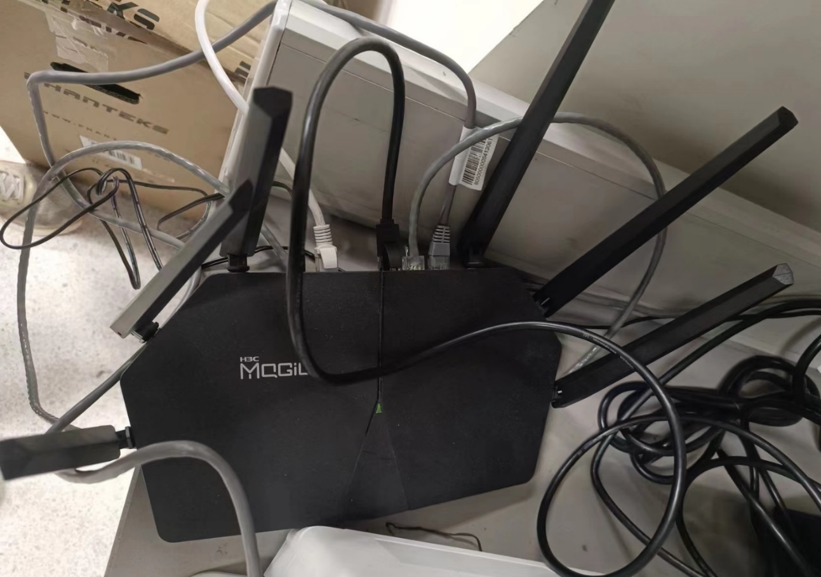
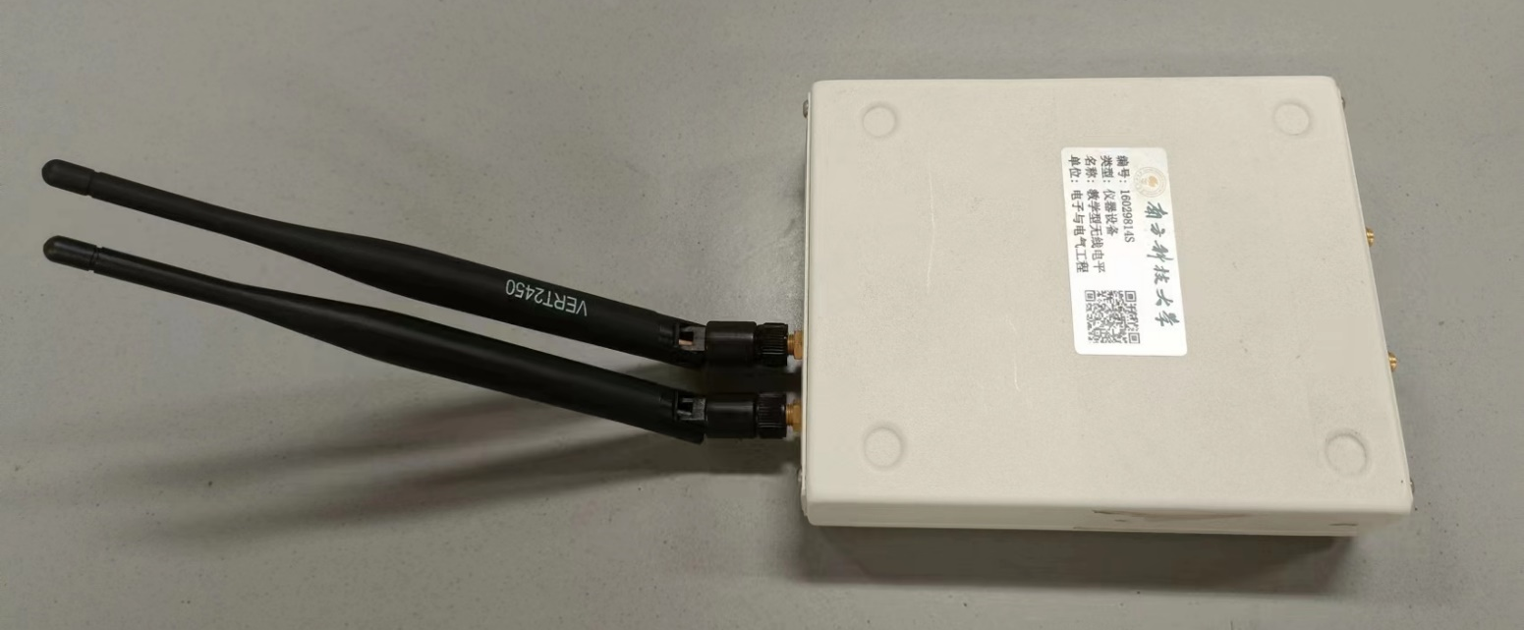
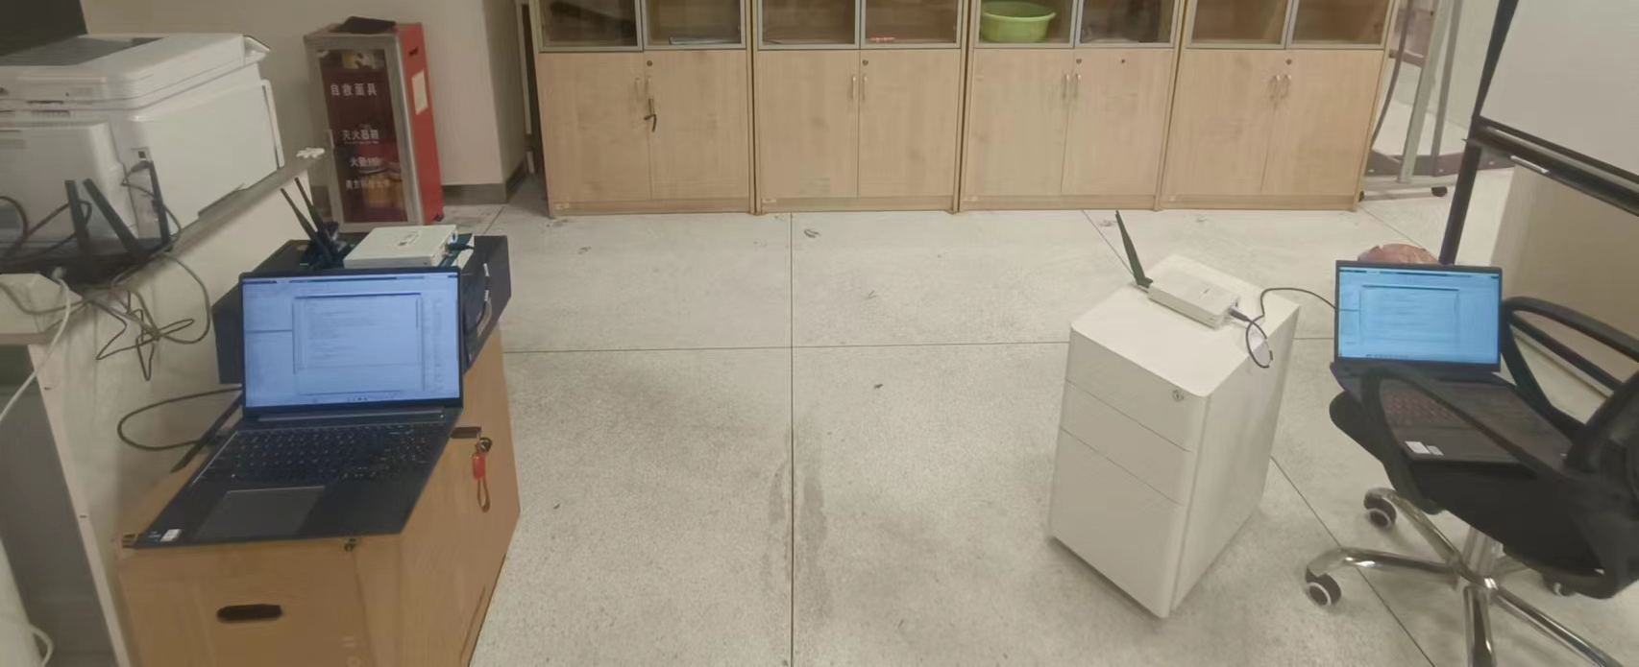

Practical System Setup
WIFI AP
Human sensing with WIFI
Device
Omni-directional Antenna
USRP NI 2900
Surveillance channel
Reference channel
Direct signal

Slide 7
Localization of WIFI AP
Why to do localization
It is usually favorable to deploy the passive radar sensor close to the WIFI AP behind the wall
The exact position of WIFI AP inside the room is unknown
How to do localization
Measuring the Angle-of-Arrival (AOA) with a PWR from multiple positions: requires a highly directional antenna to accurately measure the AOA ----- not available for WIFI
Received Signal Strength (RSS) Model Fitting Technique
Can be simply implemented by a single-channel receiver with an omnidirectional antenna
Only relies on the measurement of received signal strength and not sensitive to the signal wavelengths
Multipath propagations effects can be mitigated

Slide 8
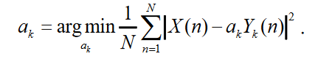
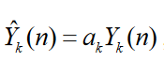
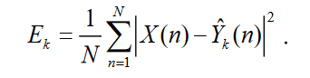
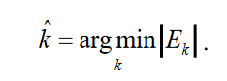
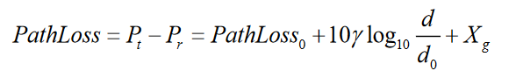
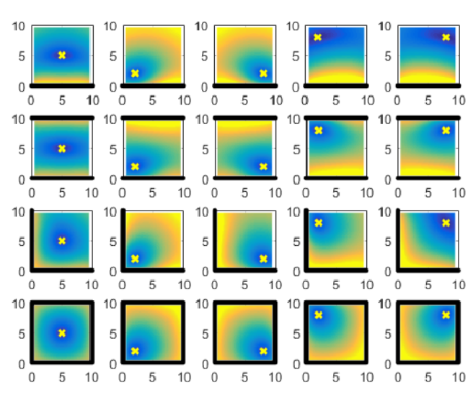
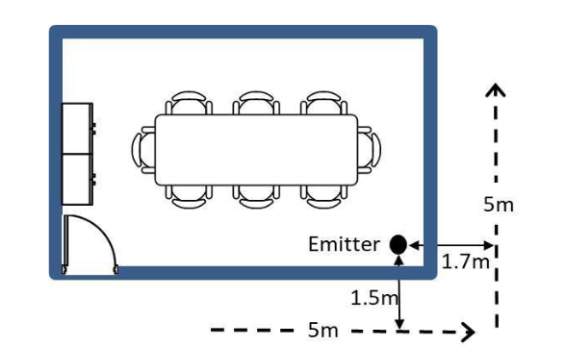
Localization of WIFI AP
Received Signal Strength (RSS) Model Fitting ——In Essay

Slide 9
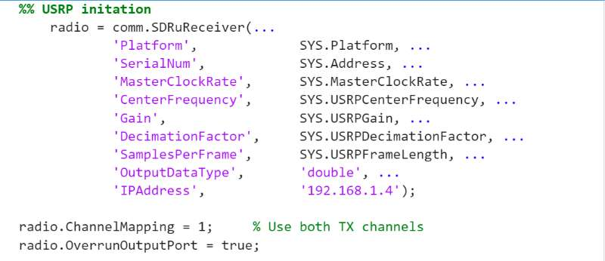
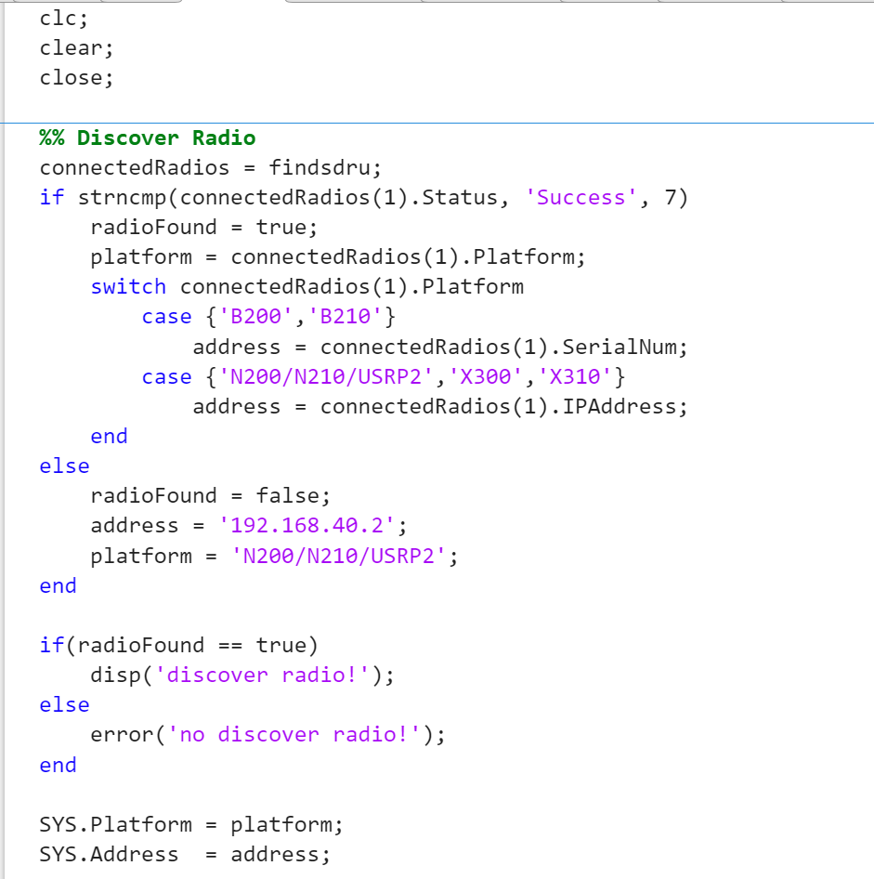
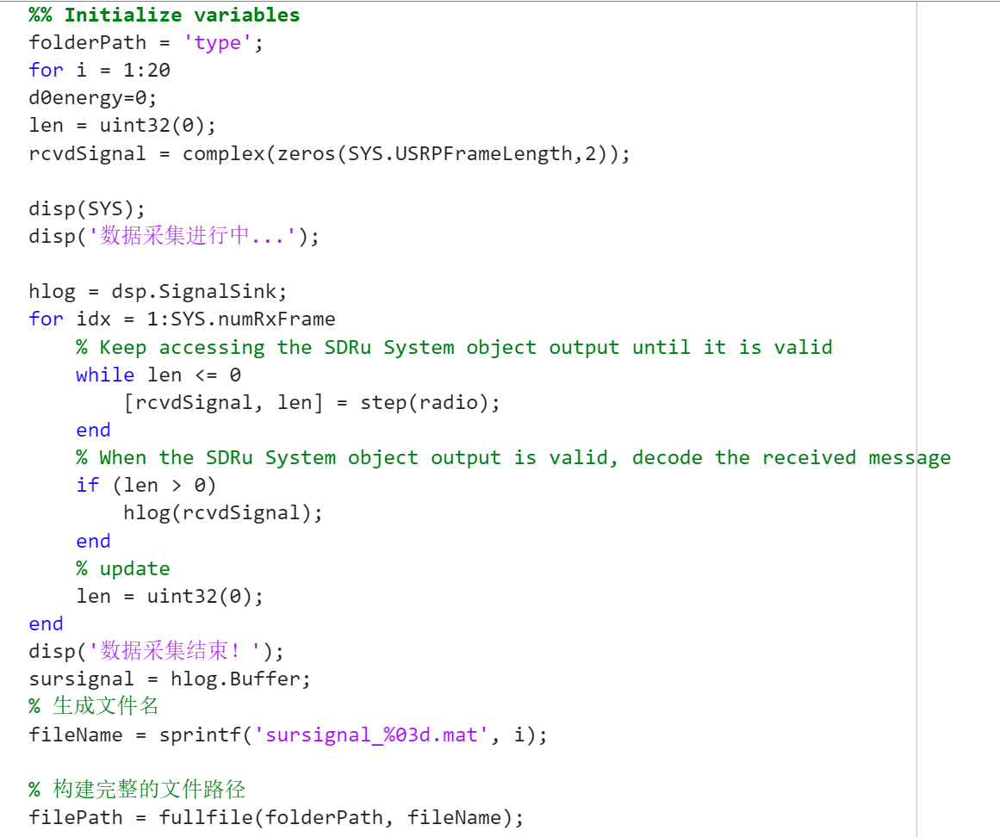
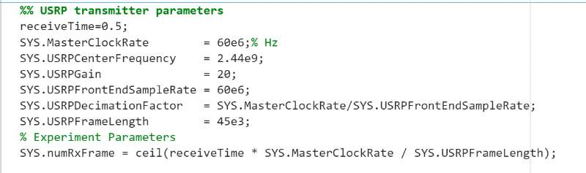
Localization of WIFI AP
Received Signal Strength (RSS) Model Fitting ——In Practical
Receive the signal program

Slide 10
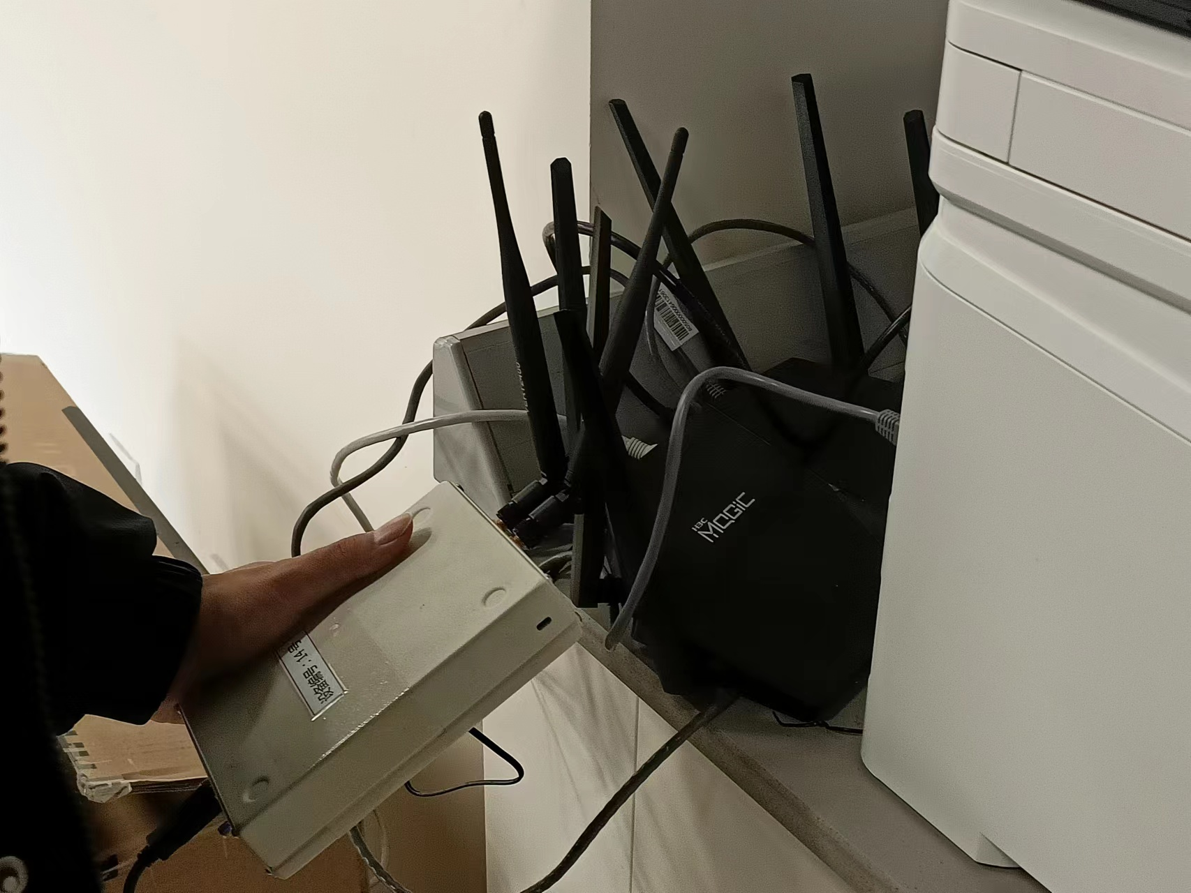
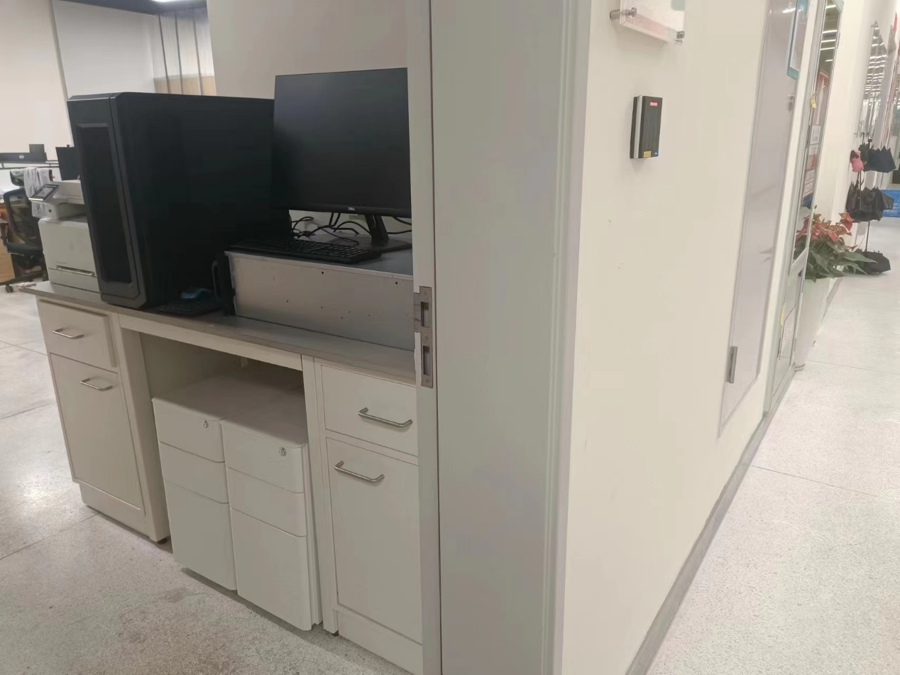
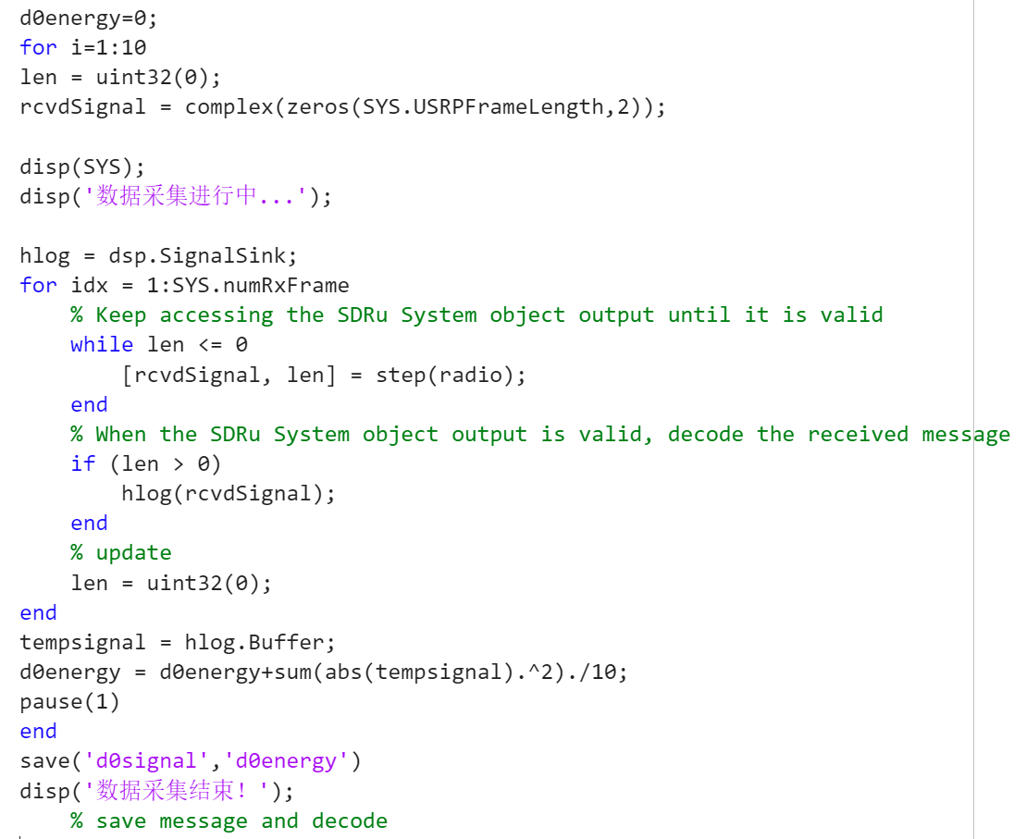
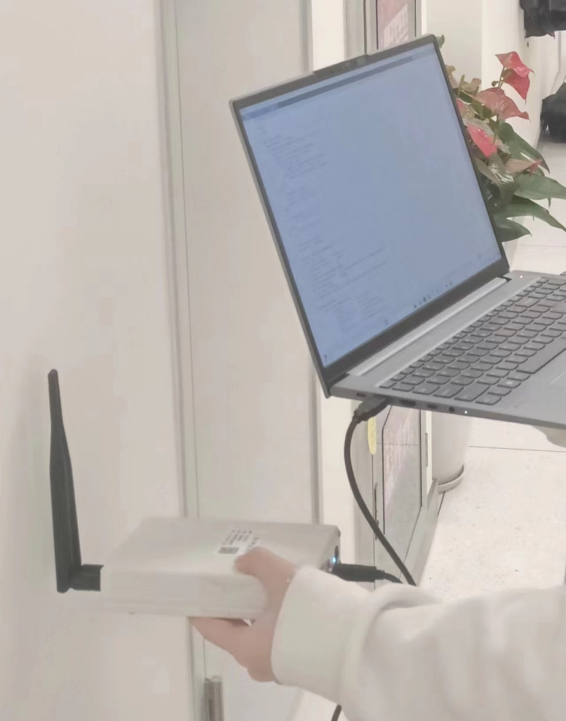
Localization of WIFI AP
Received Signal Strength (RSS) Model Fitting ——In Practical
Path loss measurements

Slide 11
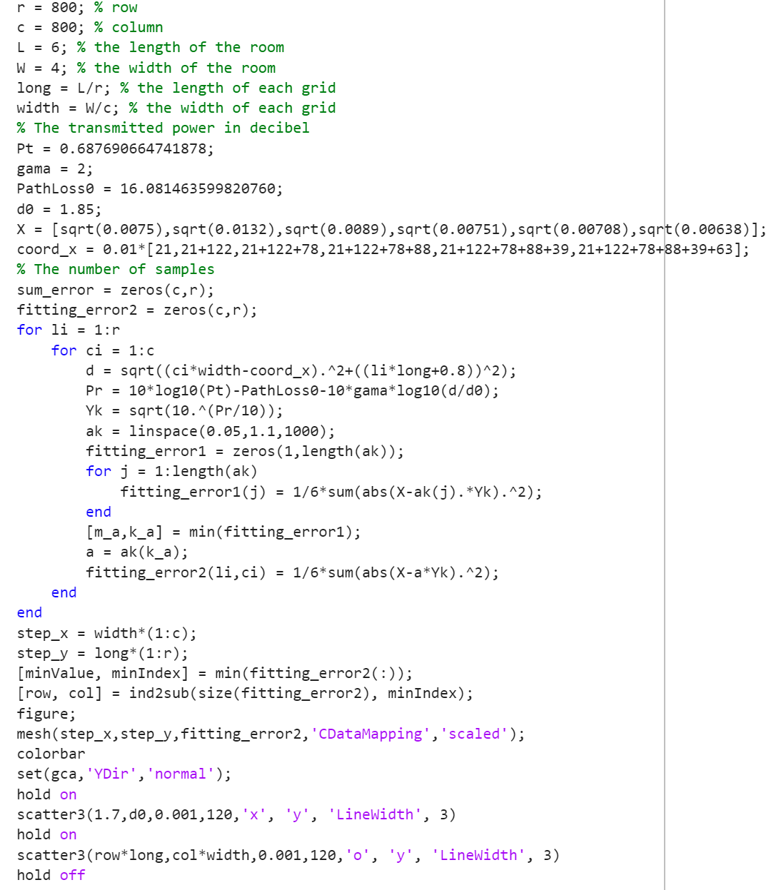
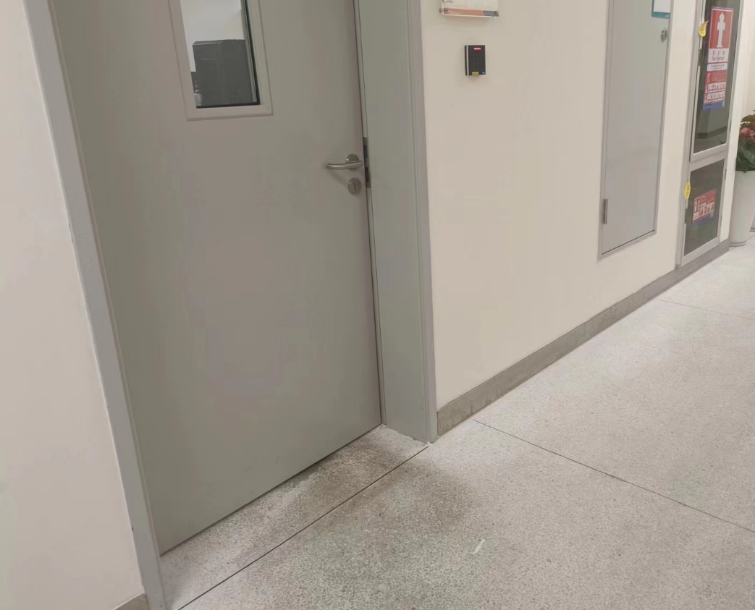
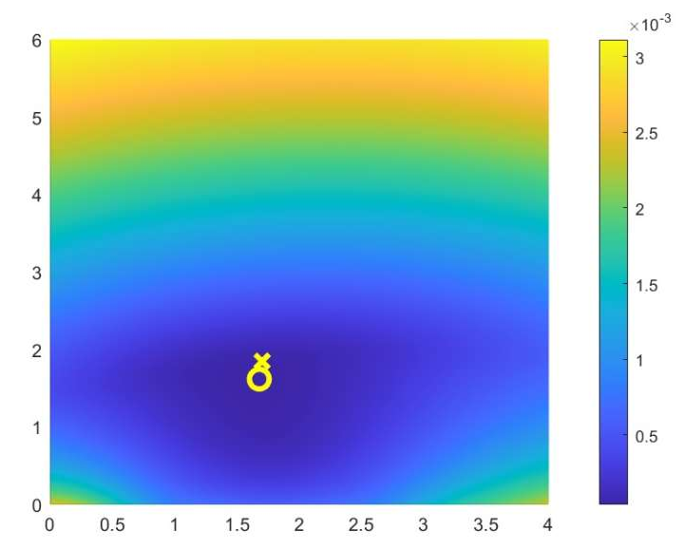
Localization of WIFI AP
Received Signal Strength (RSS) Model Fitting ——In Practical
Practical measurements
…

Slide 12
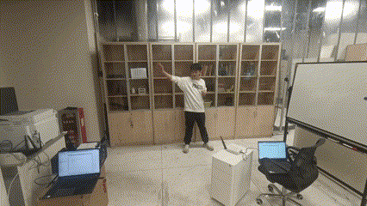
Doppler Detection of Human Motions
System Setup
Surveillance channel
Reference channel
Direct signal

Slide 13
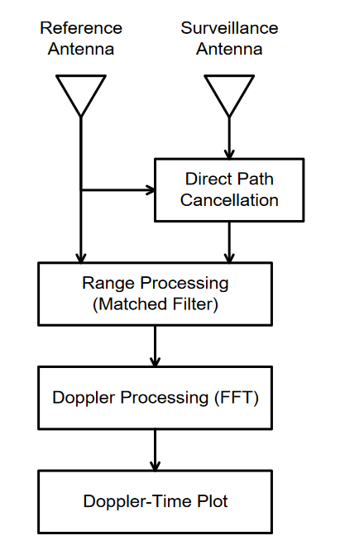
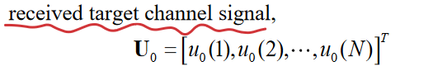
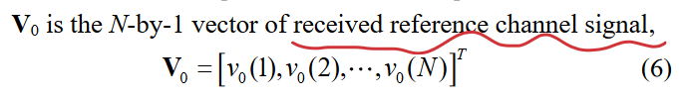
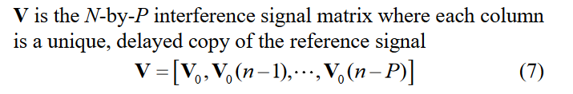
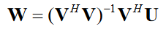
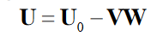
Doppler Detection of Human Motions
Signal Processing Techniques
Direct Path Cancellation
optimally weighted and subtracted from the received target echo signal based on the least square criterion

Slide 14
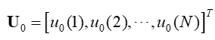
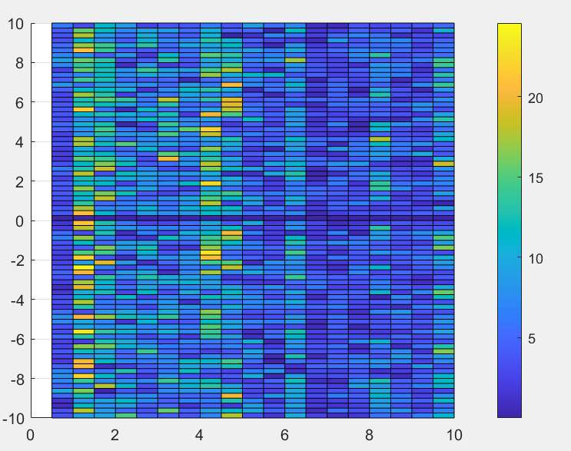
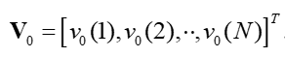
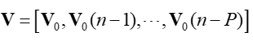
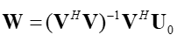
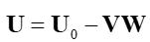
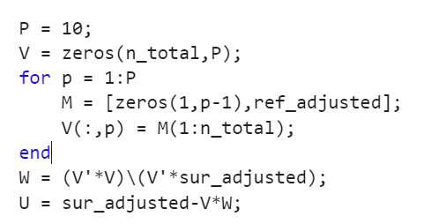
Doppler Detection of Human Motions
Signal Processing Techniques
Direct Path Cancellation

Slide 15
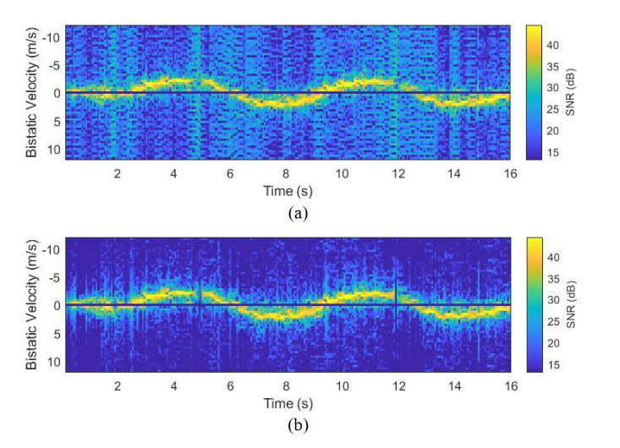
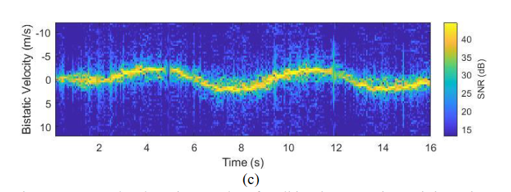
Doppler Detection of Human Motions
Multi-CIT Interference Cancellation
Some minor human motions may present very small Doppler close to zero Hertz
Conduct the interference cancellation with multiple CIT data, resulting in a reduction of the Doppler notched width

Slide 16
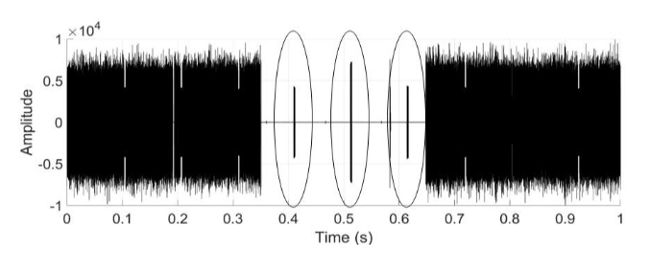
Doppler Detection of Human Motions
Beacon Signal Removal
A copy of the beacon signal is collected and stored as a reference during the gaps between WIFI data bursts before the trial was performed
Perform a cross correlation between reference beacon signal and the received WIFI signal and record the correlation peaks locations
Set the data within the duration of the detected beacon signal as zero

Slide 17
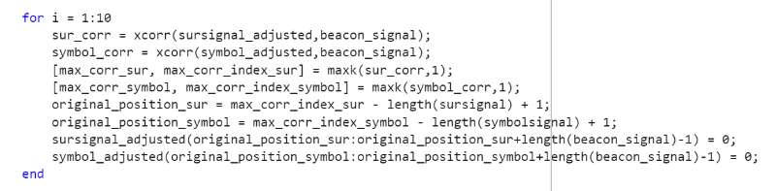
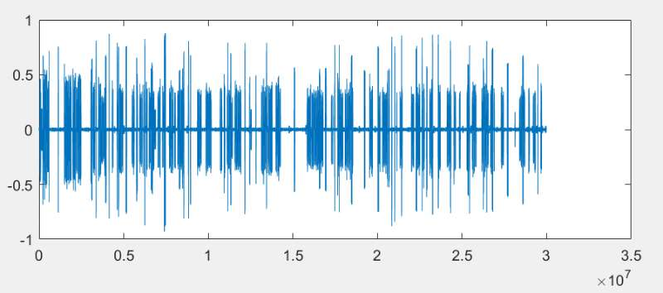
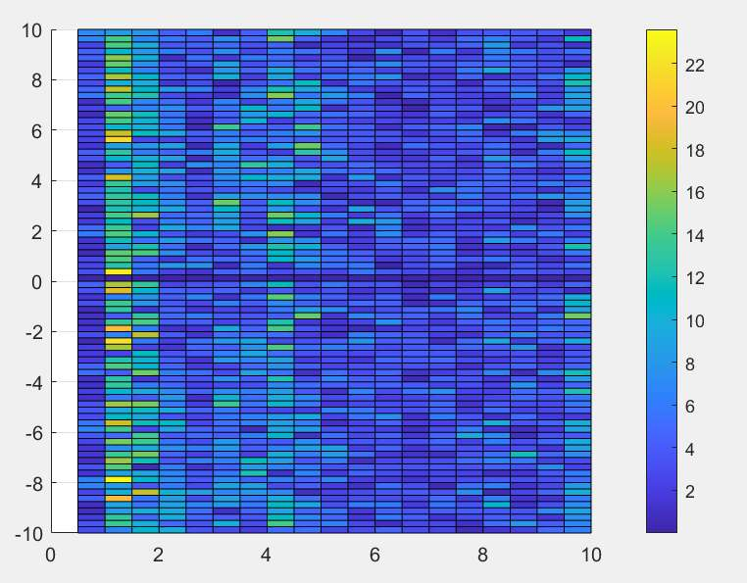
Doppler Detection of Human Motions
Signal Processing Techniques
Beacon Signal Removal

Slide 18
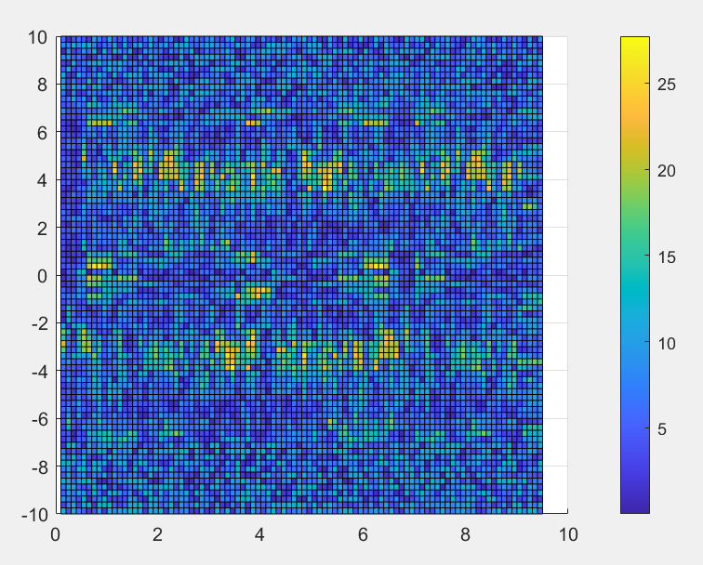
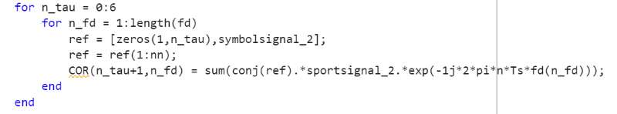



Doppler Detection of Human Motions
Hand-waving
Doppler-time
typing
No-motion

Slide 19

Thanks for your listening!

